Slide 1


A Low-Latency Online Prediction Serving System
Clipper
Dan Crankshaw
crankshaw@cs.berkeley.edu
http://clipper.ai
https://github.com/ucbrise/clipper
November 29, 2017

Slide 2


Collaborators
Corey Zumar
Nishad Singh
Xin Wang
Yujia Luo
Feynman Liang
Alexey Tumanov
Joseph Gonzalez
Ion Stoica
Michael Franklin

Slide 3
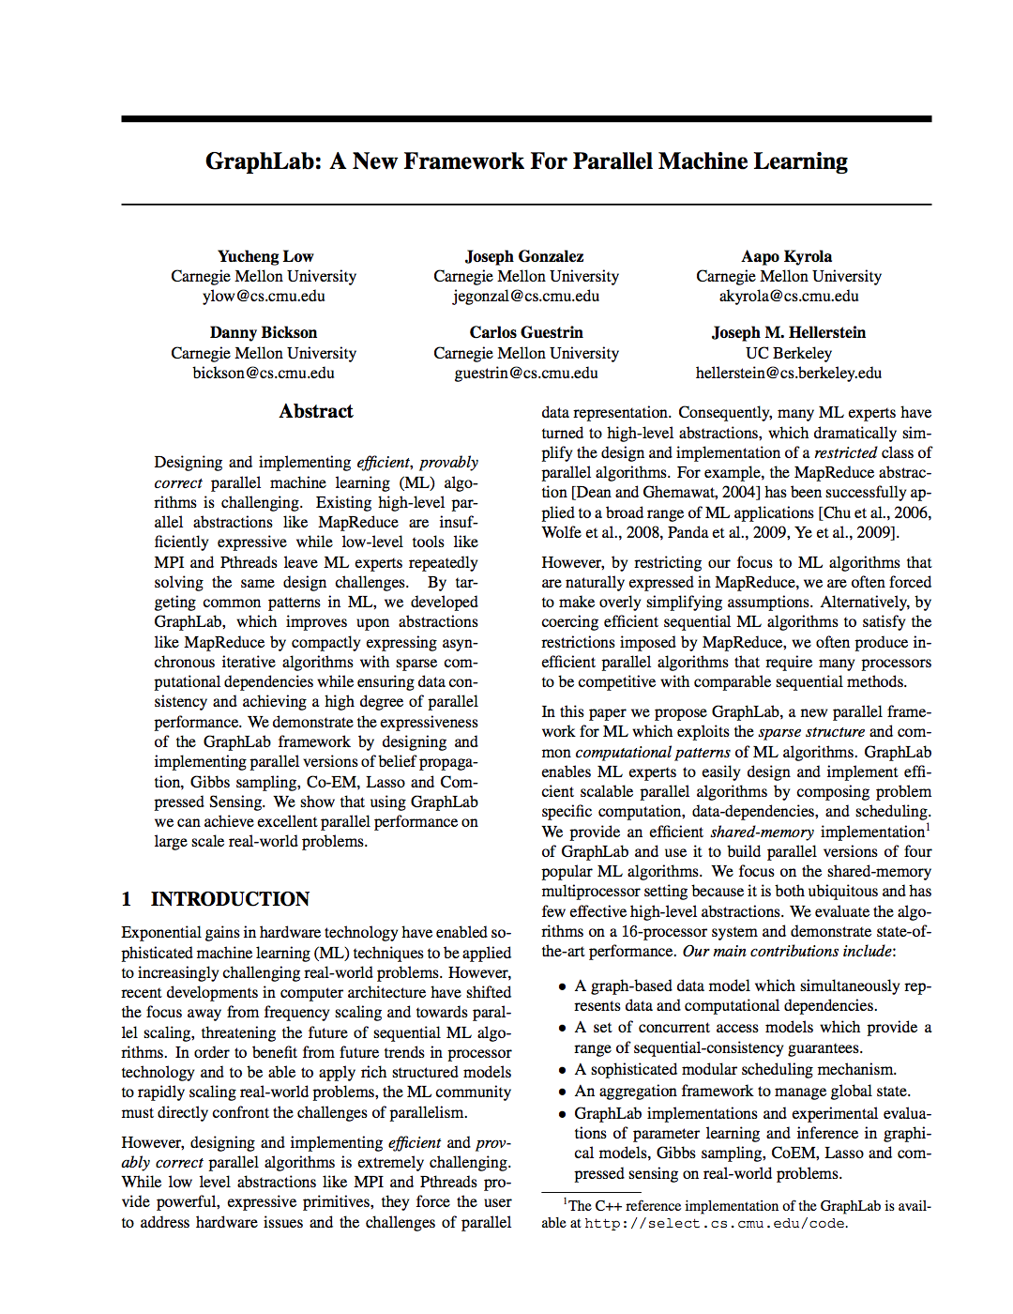
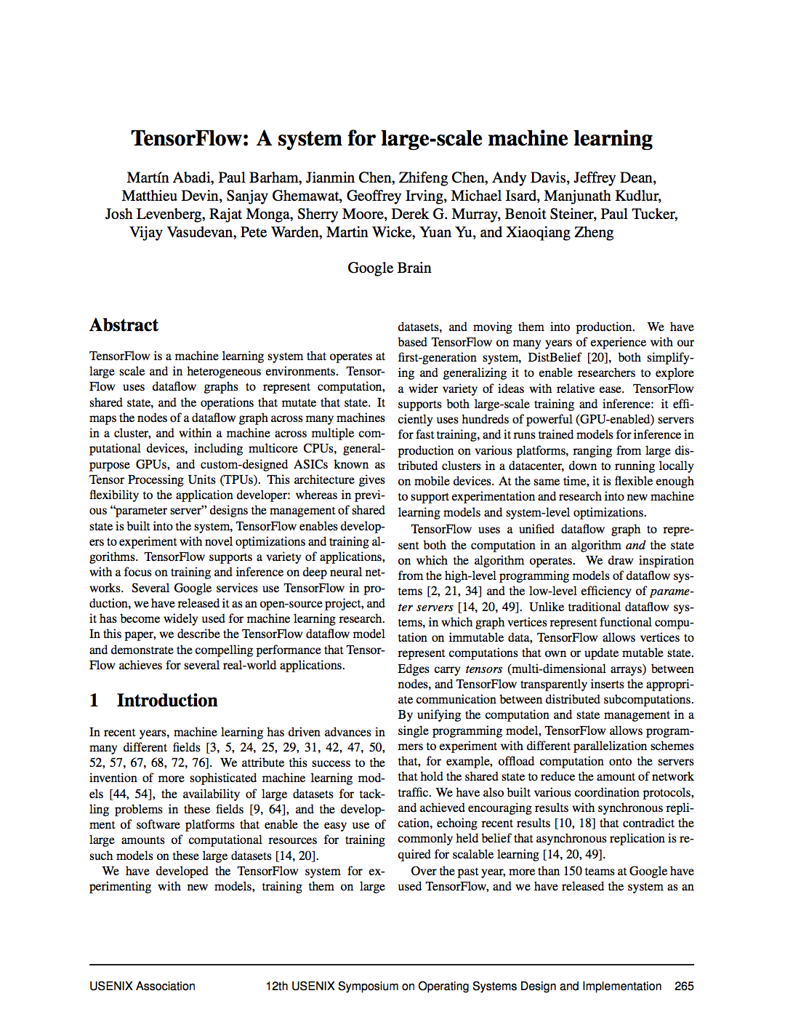
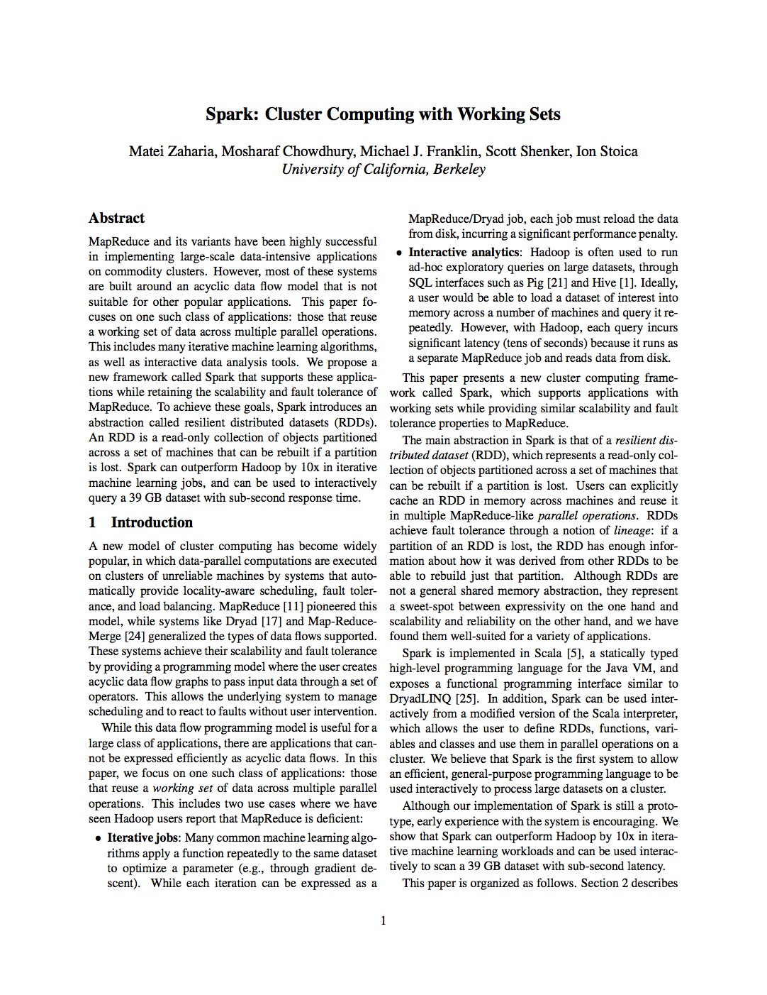
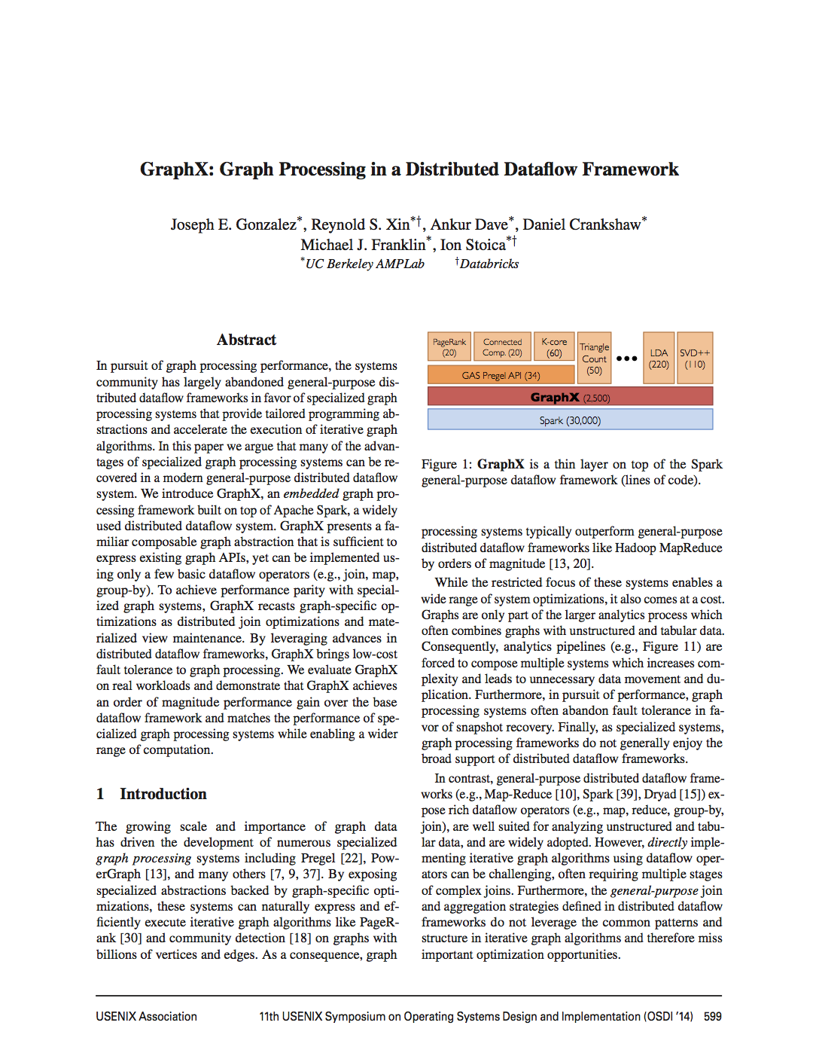
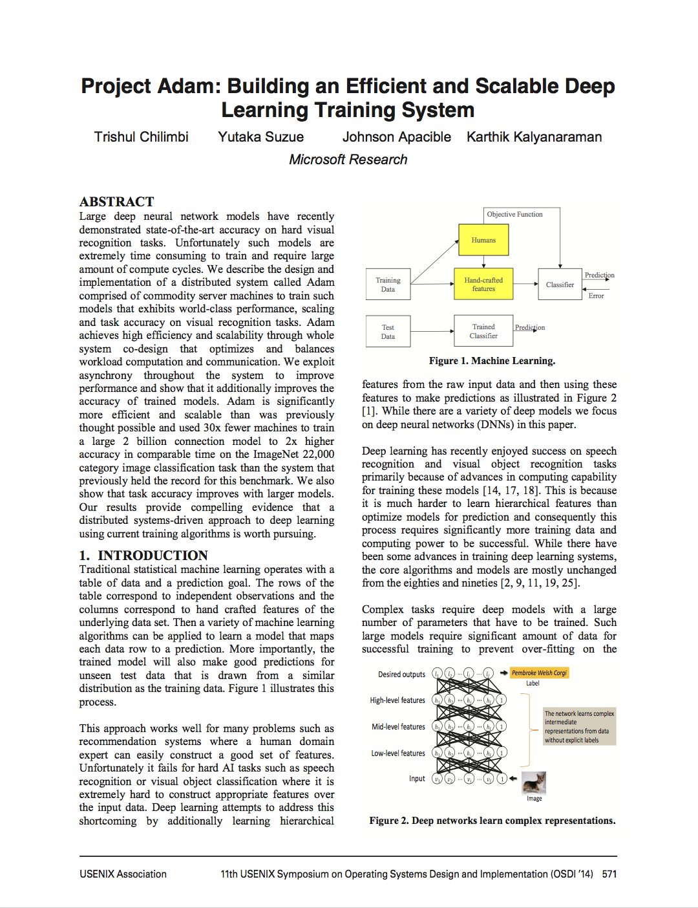
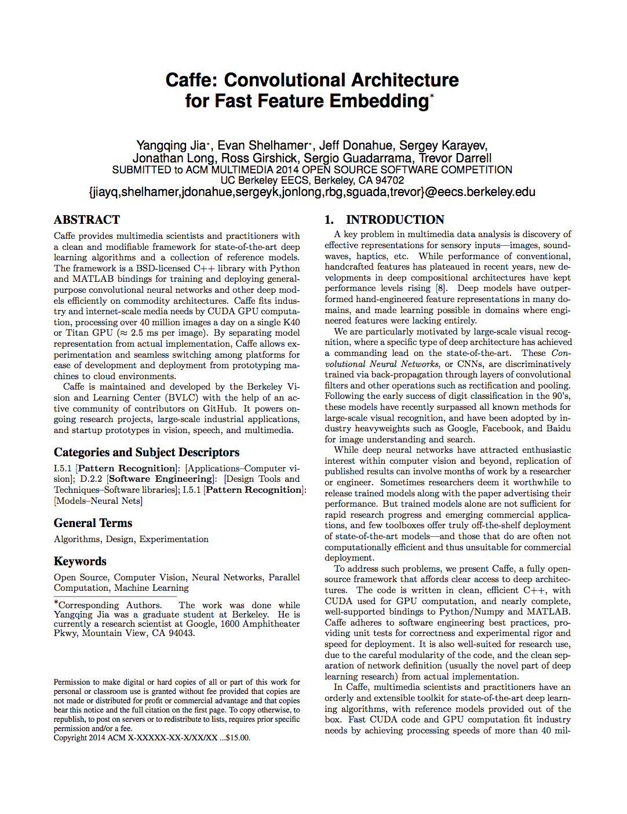
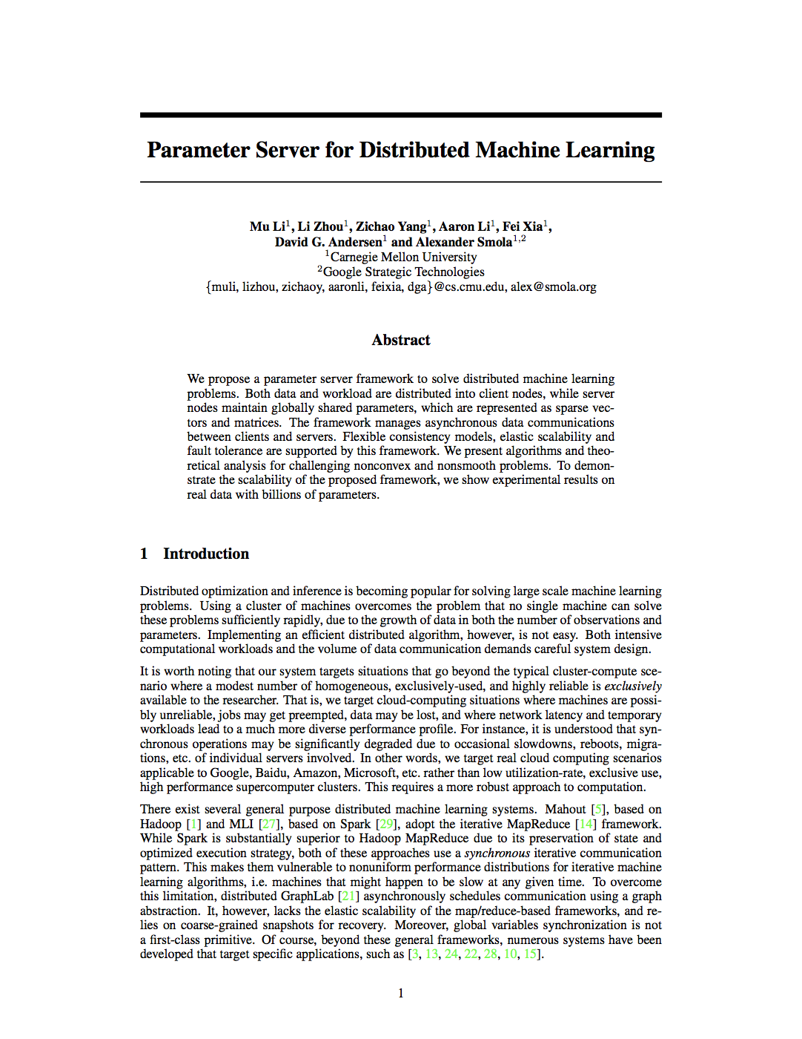
Learning
Big
Data
Training
Complex Model
Notes:
focus of systems for AI/ML has been training
cite paper logos instead of text

Slide 4
Learning
Big
Data
Training
Complex Model

Slide 5
Learning Produces a Trained Model
Query
Decision
“CAT”
Model

Slide 6
Learning
Serving
Query
Big
Data
?
Training
Decision
Model
Application

Slide 7
Serving
Learning
Query
Big
Data
Training
Decision
Model
Application
Prediction-Serving for interactive applications
Timescale: ~10s of milliseconds

Slide 8
In this talk…
Challenges of prediction serving
Clipper overview and architecture
Deploy and serve models with Clipper
Serving multi-model pipelines
Notes:
”Abstract away the model behind a uniform API”

Slide 9
Prediction-Serving Raises New Challenges

Slide 10








Prediction-Serving Challenges
???
Create
VW
Caffe
10
Large and growing ecosystem of ML models and frameworks
Support low-latency, high-throughput serving workloads

Slide 11
Support low-latency, high-throughput serving workloads
Models getting more complex
10s of GFLOPs [1]
Deployed on critical path
Maintain SLOs under heavy load
Using specialized hardware for predictions
[1] Deep Residual Learning for Image Recognition. He et al. CVPR 2015.
Notes:
FLOPs, numbers for models,

Slide 12
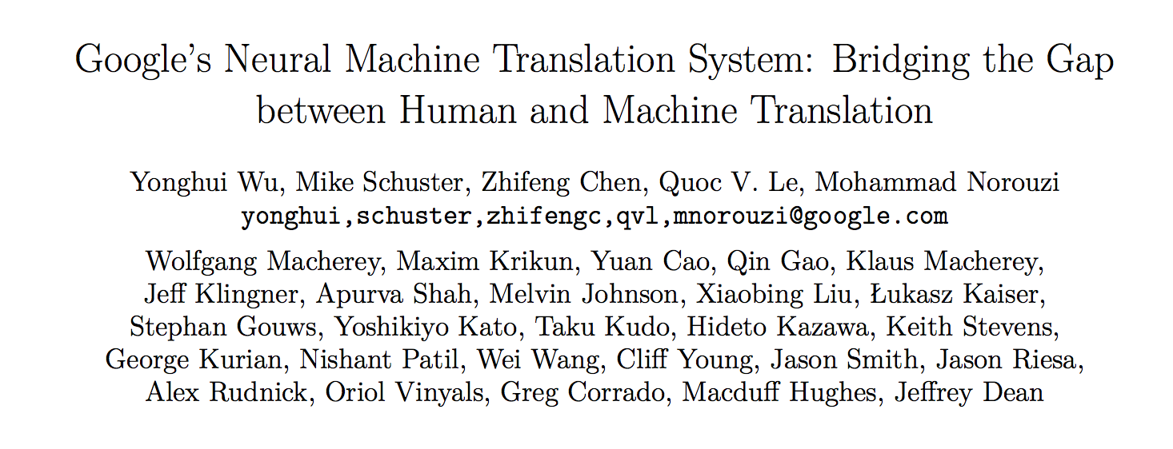
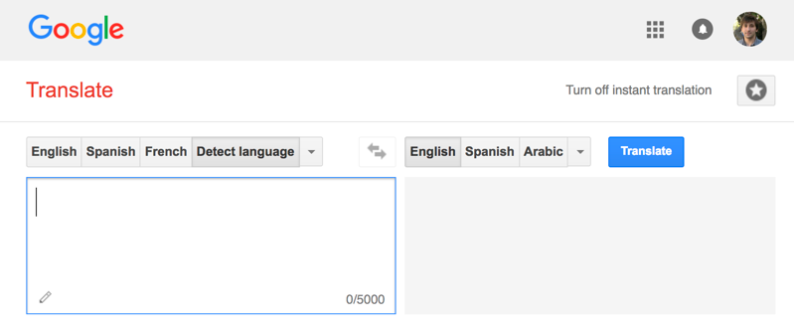
Google Translate
Serving
Invented New Hardware!
Tensor Processing Unit (TPU)
140 billion words a day¹
82,000 GPUs running 24/7
[1] https://www.nytimes.com/2016/12/14/magazine/the-great-ai-awakening.html
Notes:
Model scoring that drove Google to develop new hardware, not training

Slide 13

Big Companies Build One-Off Systems
Problems:
Expensive to build and maintain
Highly specialized and require ML and systems expertise
Tightly-coupled model and application
Difficult to change or update model
Only supports single ML framework

Slide 14
Prediction-Serving Challenges
???
Create
VW
Caffe
14
Large and growing ecosystem of ML models and frameworks
Support low-latency, high-throughput serving workloads

Slide 15

Large and growing ecosystem of ML models and frameworks
Fraud Detection
???
15
Notes:
Different models, different frameworks have different strengths
Give example of why all are needed
Multiple applications with different needs within an org
Even a single application may need to support multiple frameworks

Slide 16
Large and growing ecosystem of ML models and frameworks
Different programming languages:
TensorFlow: Python and C++
Spark: JVM-based
Different hardware:
CPUs and GPUs
Different costs
DNNs in TensorFlow are generally much slower
Fraud Detection
???
16
Notes:
Different models, different frameworks have different strengths
Give example of why all are needed
Multiple applications with different needs within an org
Even a single application may need to support multiple frameworks

Slide 17
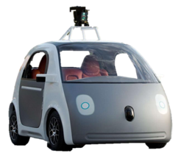





Large and growing ecosystem of ML models and frameworks
Fraud Detection
Content
Rec.
Personal
Asst.
Robotic
Control
Machine
Translation
???
VW
Create
Caffe
17
Notes:
Different models, different frameworks have different strengths
Give example of why all are needed
Multiple applications with different needs within an org
Even a single application may need to support multiple frameworks

Slide 18
Large and growing ecosystem of ML models and frameworks
Fraud Detection
Content
Rec.
Personal
Asst.
Robotic
Control
Machine
Translation
Difficult to deploy and brittle to manage
???
Varying physical resource requirements
VW
Create
Caffe

Slide 19
But building new serving systems for each framework is expensive…

Slide 20
Use existing systems: Offline Scoring
Big
Data
Training
Model
Batch Analytics

Slide 21
Use existing systems: Offline Scoring
Datastore
Big
Data
X | Y
Training
Scoring
Model
Batch Analytics

Slide 22
Use existing systems: Offline Scoring
Look up decision in datastore
Query
X | Y
Decision
Application
Low-Latency Serving

Slide 23
Use existing systems: Offline Scoring
Look up decision in datastore
Problems:
Requires full set of queries ahead of time
Small and bounded input domain
Wasted computation and space
Can render and store unneeded predictions
Costly to update
Re-run batch job
Query
X | Y
Decision
Application
Low-Latency Serving

Slide 24
Prediction-Serving Challenges
???
Create
VW
Caffe
24
Large and growing ecosystem of ML models and frameworks
Support low-latency, high-throughput serving workloads

Slide 25
Prediction-Serving Today
Query
Clipper aims to unify these approaches
X | Y
Decision
Highly specialized systems for specific problems
Offline scoring with existing frameworks and systems

Slide 26
Query
X | Y
Decision

Slide 27
two worlds
specialized systems, specific domains
Prematerialization -> unified and general purpose but limiting
Clipper aims to achieve best of both worlds
Generality of prematerialization and

Slide 28
What would we like this to look like?
Fraud Detection
Content
Rec.
Personal
Asst.
Robotic
Control
Machine
Translation
???
VW
Create
Caffe
28
Notes:
Different models, different frameworks have different strengths
Give example of why all are needed
Multiple applications with different needs within an org
Even a single application may need to support multiple frameworks

Slide 29
Encapsulate each system in isolated environment
Fraud Detection
Content
Rec.
Personal
Asst.
Robotic
Control
Machine
Translation
???
VW
Create
Caffe
29
Notes:
Different models, different frameworks have different strengths
Give example of why all are needed
Multiple applications with different needs within an org
Even a single application may need to support multiple frameworks

Slide 30

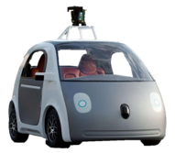

Decouple models and applications
Fraud Detection
Content
Rec.
Personal
Asst.
Robotic
Control
Machine
Translation
???
Caffe
VW
30
Create
Notes:
Different models, different frameworks have different strengths
Give example of why all are needed
Multiple applications with different needs within an org
Even a single application may need to support multiple frameworks

Slide 31
build into clipper
encapsulate ml systems in own boxes
replace red arrows with something that handles complexity
THAT is clipper

Slide 32
Clipper Decouples Applications and Models
Applications
Predict
Clipper
RPC
RPC
RPC
RPC
Model Container (MC)
MC
MC
MC
Caffe
VW
Create

Slide 33
Clipper Implementation
Applications
Predict
Clipper
Core system: 10,000 lines of C++
Open source system: https://github.com/ucbrise/clipper
Goal: Community-owned platform for model deployment and serving
Model Abstraction Layer
Caching
Adaptive Batching
RPC
RPC
RPC
RPC
Model Container (MC)
MC
MC
MC
Caffe
Notes:
Put github link

Slide 34



Clipper Implementation
Applications
Predict
Clipper
Query Processor
Clipper
Management
Redis
clipper
admin
Model Container
Model Container

Slide 35
Clipper Connects Analytics and Serving
Worker Node
Executor
Web Server
Task
Task
Worker Node
Executor
Driver Program
Cache
Task
Task
SparkContext
Worker Node
Executor
Clipper
Database
Task
Task
Notes:
sits adjacent to analytics frameworks
Clipper provides the mechanism to bridge analytics and serving

Slide 36
Getting Started with Clipper
Docker images available on DockerHub
Clipper admin is distributed as pip package:
pip install clipper_admin
Get up and running without cloning or compiling!
Notes:
so all you need to do to launch a Clipper cluster is pip install

Slide 37
How does Clipper address these challenges?
Notes:
Why a system? Because system challenges not AI challenges

Slide 38
Clipper Technologies
Container-based architecture for flexibility and scalability
Leverage common computational patterns across frameworks to maximize performance
Empower data scientists to perform online model selection to increase accuracy
Notes:
”Abstract away the model behind a uniform API”

Slide 39
How does Clipper address these challenges?
???
Create
VW
Caffe
39
Large and growing ecosystem of ML models and frameworks
Support low-latency, high-throughput serving workloads

Slide 40
Technologies inside Clipper
Containerized frameworks: unified abstraction and isolation
Cross-framework caching and batching: optimize throughput and latency
Cross-framework model composition: improved accuracy through ensembles and bandits
Notes:
”Abstract away the model behind a uniform API”

Slide 41
Clipper Design and Architecture

Slide 42
Clipper has 3 simultaneous sets of users
Devops: Responsible for ensuring that Clipper is a fast and reliable part of serving infra
Data scientists: Deploy models that they have developed into production
Frontend developers: Query Clipper for predictions

Slide 43
Prediction-Serving System:
Requirements
Decouple applications from models and allow them to evolve independently from each other
The Frontend Dev perspective: focus on building reliable, low-latency applications
Provide stable, reliable, performant APIs to meet SLAs
scale system, hardware to meet application demands
Oblivious to the implementations of the underlying models
The Data Scientist perspective: focus on making accurate predictions
Support many models and frameworks simultaneously
Simple deployment and online experimentation
(Mostly) oblivious to system performance and workload demands
Notes:
What is a model?
What is an application?

Slide 44




Clipper Implementation
Applications
Predict
RPC/REST Interface
Observe
Clipper
Core system: 35,000 lines of C++
RPC:
200 lines of Python
700 lines of Java
Model Abstraction Layer
Caching
Adaptive Batching
RPC
RPC
RPC
RPC
Model Container (MC)
MC
MC
MC
Caffe

Slide 45
Clipper Decouples Applications and Models
Applications
Predict
RPC/REST Interface
Feedback
Clipper
RPC
RPC
RPC
RPC
Model Container (MC)
MC
MC
MC
Caffe
VW
Create

Slide 46
Clipper Decouples Applications and Models
Applications
Predict
RPC/REST Interface
Feedback
Clipper
RPC
RPC
RPC
RPC
Model Container (MC)
MC
MC
MC
Caffe
VW
Create

Slide 47
Clipper Techniques
Container-based architecture for flexibility and scalability
Leverage common computational patterns across frameworks to maximize performance
Empower data scientists to perform online model selection to increase accuracy
Notes:
”Abstract away the model behind a uniform API”

Slide 48
Applications
Predict
RPC/REST Interface
Observe
Clipper
RPC
RPC
RPC
RPC
Model Container (MC)
MC
MC
MC
Caffe
Provide a common interface to models while bounding latency and maximizing throughput.

Slide 49
Clipper Decouples Applications and Models
Applications
Predict
RPC/REST Interface
Feedback
Clipper
RPC
RPC
RPC
RPC
Model Container (MC)
MC
MC
MC
Caffe
VW
Create
Common Interface → Simplifies Deployment:
Evaluate models using original code & systems

Slide 50
Container-based Model Deployment
Implement Model API:
class ModelContainer:
def __init__(model_data)
def predict_batch(inputs)
Notes:
Black-box abstraction

Slide 51
Container-based Model Deployment
Implement Model API:
class ModelContainer:
def __init__(model_data)
def predict_batch(inputs)
API support for many programming languages
Python
Java
C/C++
Notes:
Data scientist doesn’t have to learn any new skills

Slide 52
Container-based Model Deployment
Package model implementation and dependencies
Model Container (MC)
class ModelContainer:
def __init__(model_data)
def predict_batch(inputs)
VW
Create

Slide 53
Container-based Model Deployment
Clipper
RPC
RPC
RPC
RPC
Model Container (MC)
MC
MC
MC
Caffe
VW
Create
Notes:
From the frontend dev perspective Clipper

Slide 54
Clipper Decouples Applications and Models
Applications
Predict
RPC/REST Interface
Feedback
Clipper
RPC
RPC
RPC
RPC
Model Container (MC)
MC
MC
MC
Caffe
VW
Create
Common Interface → Simplifies Deployment:
Evaluate models using original code & systems
Models run in separate processes as Docker containers
Resource isolation: Cutting edge ML frameworks can be buggy

Slide 55
Clipper Decouples Applications and Models
Applications
Predict
RPC/REST Interface
Feedback
Clipper
RPC
RPC
RPC
RPC
Model Container (MC)
MC
MC
MC
Caffe
VW
Create
Common Interface → Simplifies Deployment:
Evaluate models using original code & systems
Models run in separate processes as Docker containers
Resource isolation: Cutting edge ML frameworks can be buggy
Scale-out
Problem: frameworks optimized for batch processing not latency

Slide 56
Clipper Decouples Applications and Models
Applications
Predict
RPC/REST Interface
Feedback
Clipper
RPC
RPC
RPC
RPC
RPC
RPC
Model Container (MC)
MC
MC
MC
MC
MC
Caffe
Common Interface → Simplifies Deployment:
Evaluate models using original code & systems
Models run in separate processes as Docker containers
Resource isolation: Cutting edge ML frameworks can be buggy
Scale-out

Slide 57
Overhead of decoupled architecture
Applications
Applications
Predict
RPC Interface
Predict
RPC/REST Interface
Feedback
TensorFlow-Serving
Clipper
RPC
RPC
RPC
RPC
MC
MC
MC
MC
Caffe
Notes:
adopts a more monolithic architecture with both the serving and model-evaluation code in a single process

Slide 58
Overhead of decoupled architecture
Model: AlexNet trained on CIFAR-10
Better
P99 Latency
(ms)
Throughput
(QPS)
Better
TensorFlow Serving
Clipper*
TensorFlow Serving
Clipper*
*[NSDI 17] Prototype version of Clipper
Notes:
The performance gains from a monolithic design are minimal, but the advantages of containerized system allow us to do a lot more across different frameworks
Don’t have to re-implement all this stuff for each new framework

Slide 59
Technologies inside Clipper
Containerized frameworks: unified abstraction and isolation
Cross-framework caching and batching: optimize throughput and latency
Cross-framework model composition: improved accuracy through ensembles and bandits

Slide 60
Clipper Architecture
Applications
Predict
RPC/REST Interface
Observe
Clipper
Model Abstraction Layer
Provide a common interface to models
while bounding latency and maximizing throughput.
RPC
RPC
RPC
RPC
Model Container (MC)
MC
MC
MC
Caffe
Notes:
because model-abstraction layer lets you plug in many models, model selection layer chooses between them
introduce learning in selection layer later

Slide 61
Clipper Architecture
Applications
Predict
RPC/REST Interface
Observe
Clipper
Model Abstraction Layer
Caching
Latency-Aware Batching
RPC
RPC
RPC
RPC
Model Container (MC)
MC
MC
MC
Caffe

Slide 62
Batching to Improve Throughput
Why batching helps:
Optimal batch depends on:
hardware configuration
model and framework
system load
A single
page load may generate
many queries
Throughput-optimized frameworks
Throughput
Batch size
Notes:
Make clearer that batching navigates tradeoff between throughput and latency

Slide 63
Batching to Improve Throughput
Latency-aware
Why batching helps:
Optimal batch depends on:
hardware configuration
model and framework
system load
A single
page load may generate
many queries
Clipper Solution:
Adaptively tradeoff latency and throughput…
Inc. batch size until the latency objective is exceeded (Additive Increase)
If latency exceeds SLO cut batch size by a fraction (Multiplicative Decrease)
Throughput-optimized frameworks
Throughput
Batch size
Notes:
Make clearer that batching navigates tradeoff between throughput and latency

Slide 64
Tensor Flow Conv. Net (GPU)
Better
Throughput (Queries Per Second)
Batch Size
Notes:
Two plots, thorughput on top, latency on bottom

Slide 65
Batching to Improve Throughput
Latency-aware
Why batching helps:
Optimal batch depends on:
hardware configuration
model and framework
system load
A single
page load may generate
many queries
Clipper Solution:
Adaptively tradeoff latency and throughput…
Inc. batch size until the latency objective is exceeded (Additive Increase)
If latency exceeds SLO cut batch size by a fraction (Multiplicative Decrease)
Hardware
Acceleration
Helps amortize
system overhead

Slide 66
Batching to Improve Throughput
Latency-aware
Better
Throughput
(QPS)

Slide 67
Tensor Flow Conv. Net (GPU)
Better
Throughput (Queries Per Second)
Latency (ms)
Better
Batch Size
Notes:
Two plots, thorughput on top, latency on bottom

Slide 68
Tensor Flow Conv. Net (GPU)
Better
Throughput (Queries Per Second)
Optimal Batch Size
Latency (ms)
Better
Batch Size
Notes:
Two plots, thorughput on top, latency on bottom

Slide 69
Overhead of decoupled architecture
Applications
Predict
RPC/REST Interface
Feedback
Clipper
RPC
RPC
RPC
RPC
MC
MC
MC
MC
Caffe

Slide 70
Deploying Models with Clipper

Slide 71
Goal: Connect Analytics
and Serving
Worker Node
Analytics Cluster
Executor
Web Server
Task
Task
Worker Node
Executor
Driver Program
Cache
Task
Task
Predict function
Worker Node
Executor
Clipper
Database
Task
Task

Slide 72
You can always implement your own model container…
Model Container (MC)
class ModelContainer:
def __init__(model_data):
def predict_batch(inputs):

Slide 73
Can we do better?

Slide 74
You can always implement your own model container…
Model Container (MC)
Implement model container
Build Docker image
Serialize Spark model
Deploy to Clipper
class ModelContainer:
def __init__(model_data):
# Your code here...
def predict_batch(inputs):
# Your code here...

Slide 75
Clipper admin will automatically deploy Spark models
Clipper.deploy_pyspark_model(model, predict_function)

Slide 76
Clipper admin will automatically deploy Spark models
Clipper.deploy_pyspark_model(model, predict_function)
Instance of PySpark model:
pyspark.mllib.*
pyspark.ml.pipeline.PipelineModel

Slide 77
Clipper admin will automatically deploy Spark models
Clipper.deploy_pyspark_model(model, predict_function)
Python closure
def predict_function(spark, model, inputs)
Params:
spark : SparkSession
model : ml or mllib model instance
inputs : list of inputs to predict
Returns:
list of str
Can be used for business logic, featurization, post-processing…

Slide 78
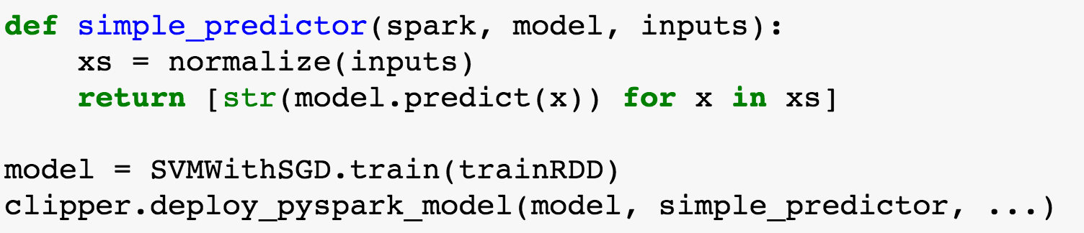
pyspark.mllib example:
Clipper.deploy_pyspark_model(model, predict_function)

Slide 79
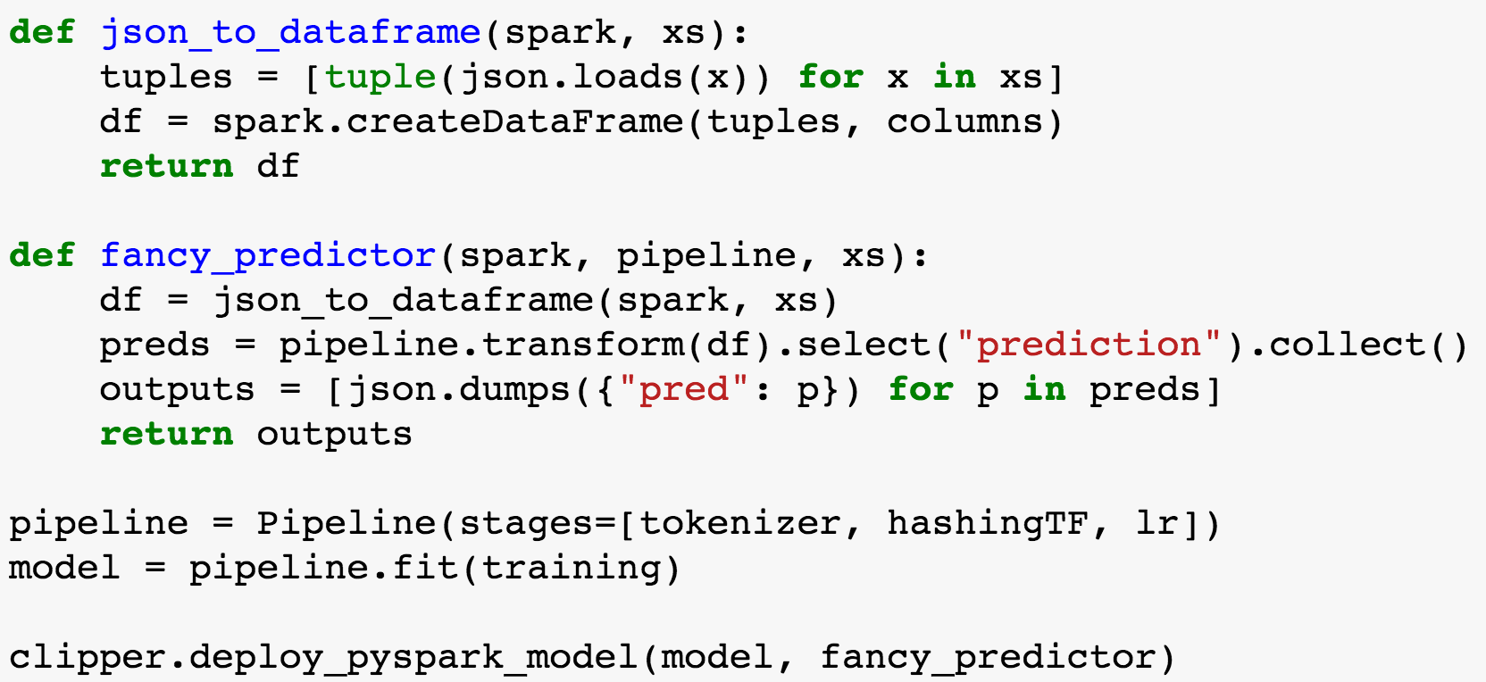
pyspark.ml.pipeline example:
Clipper.deploy_pyspark_model(model, predict_function)

Slide 80
Deploy Models from Spark to Clipper
Worker Node
Executor
Web Server
Task
Task
Worker Node
Executor
Driver Program
Cache
Task
Task
SparkContext
Worker Node
Executor
Clipper
Database
Task
Task

Slide 81
Deploy Models from Spark to Clipper
Worker Node
Executor
Web Server
Task
Task
Worker Node
Executor
Driver Program
Clipper
Cache
Task
Task
SparkContext
Worker Node
Executor
Database
Task
Task

Slide 82
Deploy Models from Spark to Clipper
Worker Node
Executor
Web Server
Task
Task
Worker Node
Executor
Driver Program
Clipper
Cache
Task
Task
SparkContext
Worker Node
MC
Executor
Database
Task
Task

Slide 83
Problem: Models don’t run in isolation
Must extract model plus pre- and post-processing logic

Slide 84
Clipper provides a library of model deployers
Deployer automatically and intelligently saves all prediction code
Captures both framework-specific models and arbitrary serializable code
Replicates training environment and loads prediction code in a Clipper model container

Slide 85
Clipper provides a (growing) library of model deployers
Python
Combine framework specific models with external featurization, post-processing, business logic
Currently support Scikit-Learn, PySpark, TensorFlow, PyTorch, Caffe2 (via ONNX), MXNet, XGBoost
Arbitrary R functions

Slide 86
MLLib example:
Clipper.deploy_pyspark_model(model, predict_function)
model = SVMWithSGD.train(trainRDD)
def predict_function(spark, model, inputs):
xs = normalize(inputs)
return [str(model.predict(x) for x in xs]

Slide 87
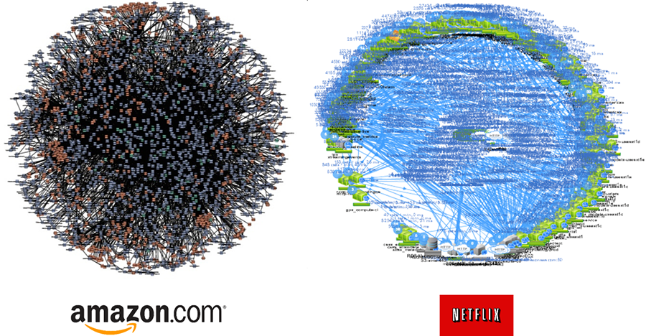
Existing Infrastructure
Load Balancer
Worker Node
Executor
Task
Task
Web Server
Web Server
Worker Node
Executor
Driver Program
Cache
Task
Task
SparkContext
Worker Node
Executor
Database
Task
Task

Slide 88
Clipper Connects Analytics and Serving
Load Balancer
Worker Node
Executor
Task
Task
Web Server
Web Server
Analytics
Cluster
Serving Cluster
Worker Node
Executor
Driver Program
Cache
Task
Task
SparkContext
Worker Node
Executor
Database
Task
Task

Slide 89
Key Abstractions
Applications: create REST endpoint
Models:
versioned, new versions automatically transferred to application
Containers
Instance of a model/version
immutable once started
Can be replicated to increase throughput
(Usually) a Docker container
Notes:
example registering endpoints
endpoints get attached to different models

Slide 90
Clipper Admin
Primary method of starting and managing Clipper is through a Python client-side library
Get: pip install clipper_admin
clipper_admin can install and provision a whole cluster for you, no need to build or compile anything

Slide 91
Goal: Connect Analytics
and Serving
Worker Node
Analytics Cluster
Executor
Web Server
Task
Task
Worker Node
Executor
Driver Program
Cache
Task
Task
Predict function
Worker Node
Executor
Clipper
Database
Task
Task

Slide 92
Run on Kubernetes alongside other applications
Web Server
Other applications
Other applications
Clipper
Cache
Other applications
MC
Database
Other applications

Slide 93
Register application
Serving stack
Spark cluster
Clipper management frontend
ClipperQuery frontend
Redis

Slide 94
Query Clipper (life of a query)
Serving stack
Spark cluster
Clipper management frontend
ClipperQuery frontend
Redis

Slide 95
Deploy Spark model (Python)
Highlight no need to write own model container
Spark cluster
model + pred function (can include featurization)
Notes:
Special sauce

Slide 96
Deploy Spark model (Scala)
Spark cluster
model + pred function (can include featurization)

Slide 97
Query Clipper (life of a query)
Serving stack
Spark cluster
ClipperQuery frontend
Clipper management frontend
Redis
Container

Slide 98
DEMO
http://clipper.ai/examples/spark-demo/
Notes:
http://clipper.ai/examples/spark-demo/

Slide 99
Clipper manager: other functionality
API Documentation at http://docs.clipper.ai
add_containers: increase throughput
set_model_version: rollback/roll-forward
See clipper config state:
get_all_apps()
get_all_models()
get_all_containers()
Debugging:
inspect_instance(): get runtime performance statistics
get_logs(): get all container logs
Clean up:
remove_inactive_container(): gc containers for out of date model versions
stop_all(): stop all Docker containers associated with Clipper

Slide 100
Status of the project
https://github.com/ucbrise/clipper
0.2 released in September, 0.3 release under way
Actively working with early users
Post issues and questions on GitHub and subscribe to our mailing list clipper-dev@googlegroups.com

Slide 101
Serving Multi-Model Pipelines (Work In Progress)

Slide 102
Technologies inside Clipper
Containerized frameworks: unified abstraction and isolation
Cross-framework caching and batching: optimize throughput and latency
Cross-framework model composition: improved accuracy through ensembles and bandits
*Explored in research prototype
[NSDI 2017]
Notes:
”Abstract away the model behind a uniform API”

Slide 103
Clipper Architecture
Applications
Predict
RPC/REST Interface
Observe
Clipper
Improve accuracy through bandit methods and ensembles, online learning, and personalization
Model Selection Layer
Model Abstraction Layer
Provide a common interface to models
while bounding latency and maximizing throughput.
RPC
RPC
RPC
RPC
Model Container (MC)
MC
MC
MC
Caffe
Notes:
because model-abstraction layer lets you plug in many models, model selection layer chooses between them
introduce learning in selection layer later

Slide 104
Clipper Architecture
Applications
Predict
RPC/REST Interface
Observe
Clipper
Model Selection Layer
Selection Policy
Model Abstraction Layer
Caching
Adaptive Batching
RPC
RPC
RPC
RPC
Model Container (MC)
MC
MC
MC
Caffe

Slide 105
Clipper Architecture
Applications
Predict
RPC/REST Interface
Observe
Clipper
Model Selection Layer
Selection Policy
Model Abstraction Layer
RPC
RPC
RPC
RPC
Model Container (MC)
MC
MC
MC
Caffe
Notes:
because model-abstraction layer lets you plug in many models, model selection layer chooses between them
introduce learning in selection layer later

Slide 106

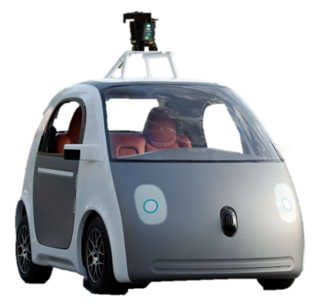
Applications
Predict
RPC/REST Interface
Observe
Clipper
Model Selection Layer
Selection Policy
Exploit multiple models to estimate confidence
Use multi-armed bandit algorithms to learn optimal model-selection online
Online personalization across ML frameworks

Slide 107
Applications
Predict
RPC/REST Interface
Observe
Clipper
Model Selection Layer
Selection Policy
Version 1
Periodic retraining
Version 2
Version 3
Experiment with new models and frameworks
Notes:
By combining predictions from multiple models we can improve application accuracy and quantify confidence in predictions

Slide 108
Selection Policy: Estimate confidence
Version 2
Version 3
“CAT”
“CAT”
CONFIDENT
“CAT”
Policy
“CAT”
“CAT”

Slide 109
Selection Policy: Estimate confidence
“CAT”
“CAT”
UNSURE
“MAN”
Policy
“CAT”
“SPACE”
Notes:
“Not a cat picture”

Slide 110
Model Composition Patterns
Else
Slow but accurate model
Task-specific model
If face detected
Face detector
If object detected
Fast model
If confident then return
Pre-trained DNN
Object detector
Ensembles can improve accuracy
Faster inference with prediction cascades
Faster development through model-reuse
Model specialization
How to efficiently support serving arbitrary model pipelines?

Slide 111
Challenges of Serving Model Pipelines
Complex tradeoff space of latency, throughput, and monetary cost
Many serving workloads are interactive and highly latency-sensitive
Performance and cost depend on model, workload, and physical resources available
Model composition leads to combinatorial explosion in the size of the tradeoff space
Developers must make decisions about how to configure individual models while reasoning about end-to-end pipeline performance

Slide 112
Configuration and Deployment Decisions
Physical resource allocation
How many GPUs? (Usually decision is either 0 or 1)
How many CPU cores?
Batch size
How much of the end-to-end latency budget should be allocated to each model?
Replication factor
How many replicas of each model in the pipeline are needed?
How to achieve a balanced system?

Slide 113
Opportunity: Exploit Properties of Inference Computation
Inference is stateless
Performance of models can be profiled independently
End-to-end pipeline performance is deterministic function of individual model performances
Perfect elastic scaling through query-level parallelism
Inference is embarrassingly parallel so any level of throughput can be achieved via replication and scaleout
Inference is compute-intensive
Minimal contention achieved by pinning to compute resources
Lack of IO leads to highly predictable performance

Slide 114
Solution: Workload-Aware Optimizer
Individual models registered with Clipper in a model repository
Developers define pipelines by writing Python programs containing arbitrary code intermingled with calls to the Clipper-hosted models for maximum flexibility
To deploy a pipeline, developer provides the optimizer with the program, a sample workload (e.g. validation dataset), and performance or cost constraints
Optimizer finds optimal pipeline configuration that meets constraints
Deployed models use Clipper as physical execution engine for serving

Slide 115
Optimizer from 10,000 feet
Lineage-based pipeline extraction
Evaluate program on user-provided sample workload to extract pipeline dependency structure
Profile each model in pipeline individually
Empirically measure model performance under each possible configuration (physical resource allocation and batch size)
Use an iterative greedy algorithm to find optimal pipeline configuration subject to user-provided performance or cost constraints
Output computational resource allocation, batch size, and replication factor for each model in the pipeline

Slide 116
Conclusion
Challenges of serving increasingly complex models trained in variety of frameworks while meeting strict performance demands
Clipper adopts a container-based architecture and employs prediction caching and latency-aware batching
Clipper’s model deployer library makes it easy to deploy both framework-specific models and arbitrary processing code
Ongoing efforts on a workload-aware optimizer to optimize the deployment of complex, multi-model pipelines
http://clipper.ai

Slide 117
Status and Roadmap
Alpha release (0.1.3) available: more info at http://clipper.ai
Support single-model applications
First class support for Scikit-Learn and Spark models
Deploy directly from training job without writing Docker containers
Roadmap:
Ongoing efforts to support for additional frameworks
TensorFlow (supported but requires writing Docker containers)
R (open pull request using Python-R interop library)
Caffe2
Bandit methods
Kubernetes integration (early internal prototype)

Slide 118
Conclusion
Prediction-serving is an important and challenging area for systems research
Support low-latency, high-throughput serving workloads
Serve large and growing ecosystem of ML frameworks
Clipper is a first step towards addressing these challenges
Simplifies deployment through layered architecture
Serves many models across ML frameworks concurrently
Employs caching, adaptive batching, container scale-out to meet interactive serving workload demands
Beyond academic prototype to build a real, open-source system
TODO
http://clipper.ai
crankshaw@cs.berkeley.edu

Slide 119
GPU Cluster Scaling

Slide 120
Better
Throughput
(QPS)
Add DNN chart?

Slide 121
Better
Throughput
(QPS)

Slide 122
Better
Throughput
(QPS)
P99 Latency
(ms)
20 ms is
Fast Enough
Better

Slide 123
Throughput
(QPS)
P99 Latency
(ms)
Batch Size
Notes:
put batching on bottom

